Slide 1
Sip-25.S2 Sprint 2 Sprint Demonstration
Monika Ravulakole SPM

Slide 2
Sprint InFormation
Sprint Name: SIP-25.S2 Sprint 2
Duration: June 2 – June 30, 2025
Demo Date: 6/20/25
Team: SIP-25
Presenter(s): Charles Beck
Diego Gonzalez
Zahra Berro

Slide 3
SPRINT DEMONSTRATION:
Total stories assigned: 3
1- QA Verify report definition
2- DB table definition
3-Code development from XML to DB
Completed work: Story 1 and 2
Carried over work: Story 3
SMEs/Support Members: Kevin Russo, Laurent Lawton and Monika Ravulakole
Brief Summary: We have completed Stories 1 and 2, which involved analyzing reporting options and defining and restructuring the database . For Story 3, we have completed 50% of the work, the XML is being parsed, and some data has been populated but a few tables still need to be filled to complete the story.

Slide 4
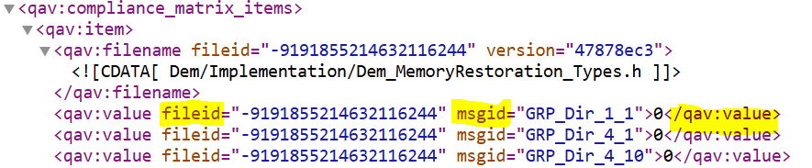
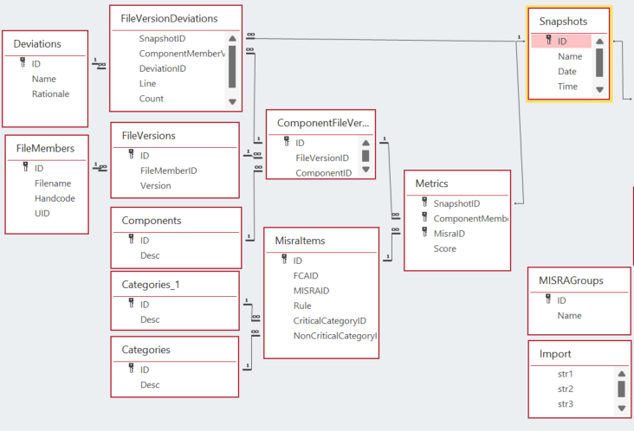
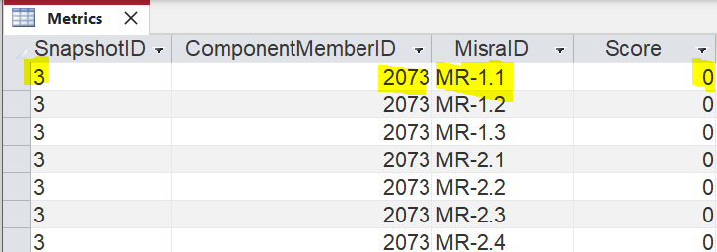
XML Report
Table Relationships from Database
Metrics table from Database

Slide 5
Thank you for your attention

